Slide 1

Static methods and properties
By Min Thet Naing

Slide 2
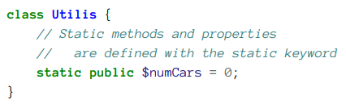
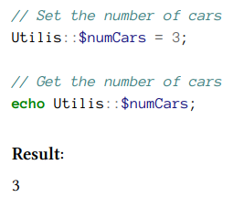
By Min Thet Naing

Slide 3
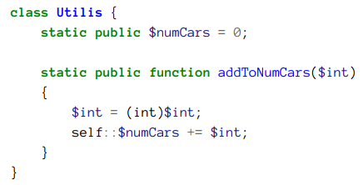
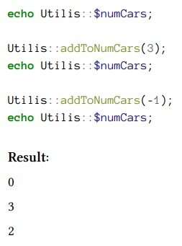
Use static method within the class
By Min Thet Naing

Slide 4
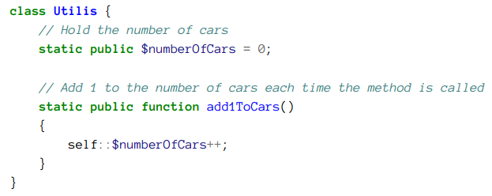
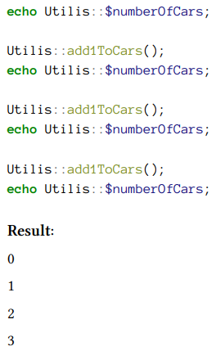
Use case as counters
By Min Thet Naing

Slide 5
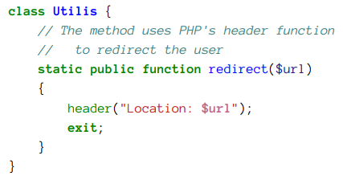
Use case for utility classes
The purpose of utility method is to perform
all kinds of tasks, such as:
conversion between measurement systems
(kilograms to pounds), data encryption,…
By Min Thet Naing

